Slide 1
Team 7
Restaurant Menu Expert
Mentor TA
Adithya Arun
Team Members
Tirth Pandit ( 2019201017 - Mtech CSE )
Jay Krishna ( 2019201019 - Mtech CSE )
Smit Khanpara ( 2019201021 - Mtech CSE )
Pratik Tiwari ( 2019201023 - Mtech CSE )
Dharmesh Gusai ( 2019201025 - Mtech CSE )
GitHub Repo Link : https://github.com/Digital-Image-Processing-IIITH/project-team-7.git

Slide 2
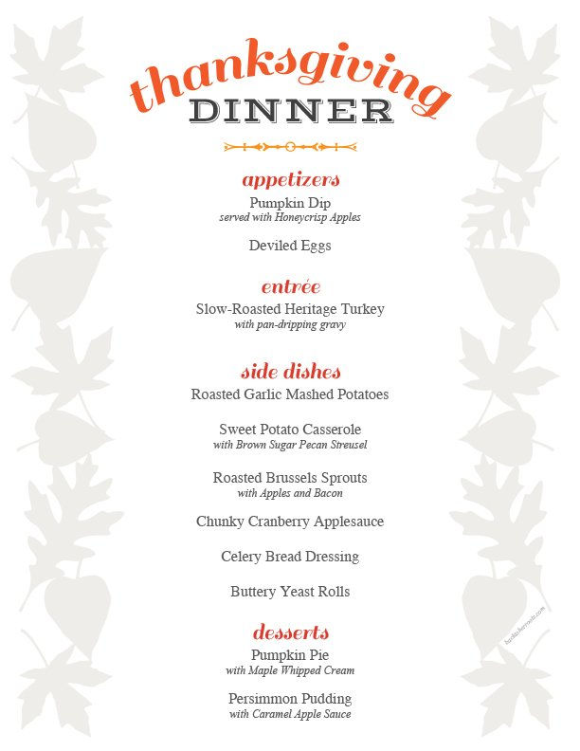
Introduction
Its a System that translates the text in English restaurant menus into pictures of the dishes.
Takes photo of a menu that users take with a camera as an input
It then processes it to retrieve the corresponding pictures of the dishes from database
Finally displays the pictures of Dishes with its names to users
Application
Helps Non-English Speakers To get visualization of dishes in the menu

Slide 3
Features Of the Pipeline
Pipeline Corrects input image rotation by performing featureless rotation
Which reduces search space and noise by identifying the ROI.
Pipeline does post-processing with edit-distance error
Improve accuracy from the Tesseract OCR engine.
System can attain 50% higher in accuracy rate than the plain OCR recognition without our pipeline.

Slide 4
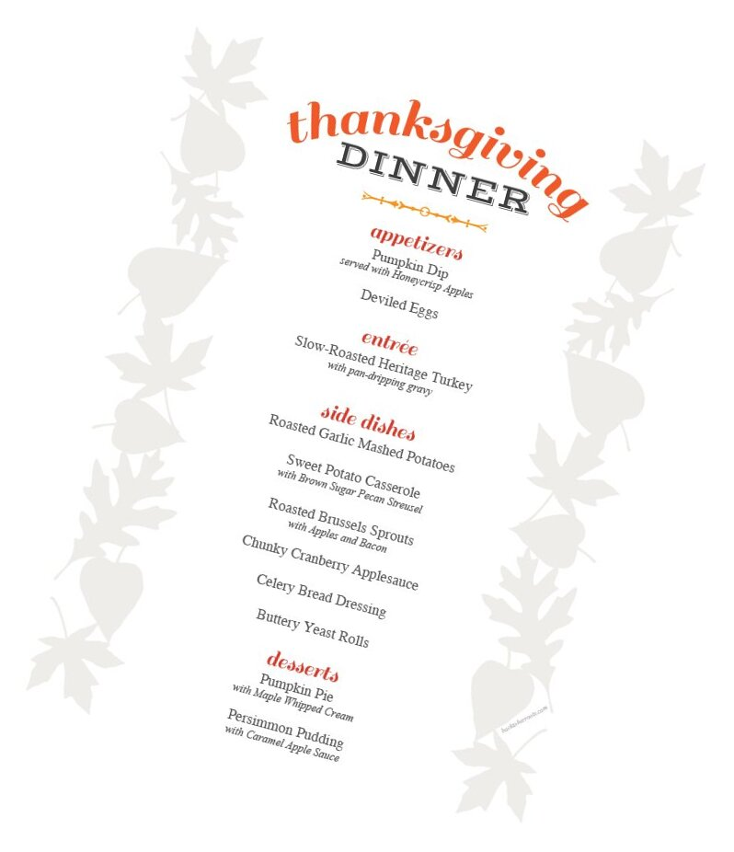
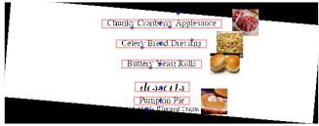
Example
Source : https://web.stanford.edu/class/ee368/Project_Autumn_1516/Reports/Wang_Chen_Lang.pdf

Slide 5
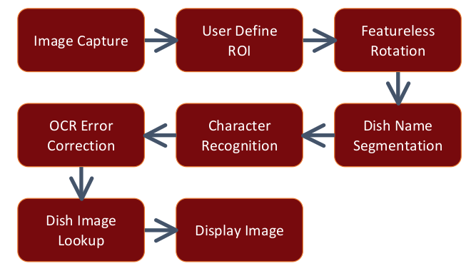
Proposed Pipeline
Source : https://web.stanford.edu/class/ee368/Project_Autumn_1516/Reports/Wang_Chen_Lang.pdf

Slide 6
Original Image
Rotation Angle : 15

Slide 7
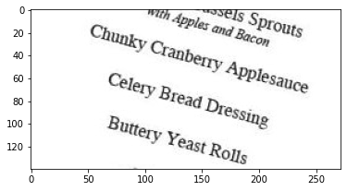
Image Capture
User takes a photo of the menu with a camera.
We provided an interface to Select ROI from captured image
We assume user takes photo such that other variables that may result from the environment such as motion blur and out out-of-focus image don't effects the input image.
ROI Selection

Slide 8
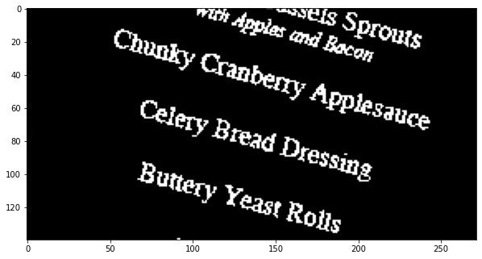
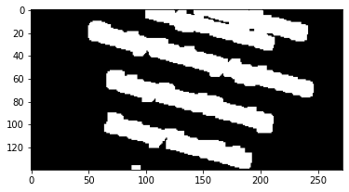
Otsu Thresholding & Dilation
Disk Dilation
OTSU Thresholding
Structural Element
Disk with radius 5
Creates Connected Components

Slide 9
FeatureLess Rotation
It automatically finds out the rotation angle based on the inherent structure of menu where most texts are horizontally aligned
First global otsu thresholding and then dilation which creates connected components and then we can create bounding boxes around them
With these bounding boxes of the connected components, we calculate the mean aspect ratios between the width and the height of the bounding boxes at every 10° from -90° to 90° with subsequent refinement of every 1° to pinpoint the angle of rotation.
From these set of rotations, we automatically find the largest mean aspect ratios, as that suggests that most bounding boxes are horizontal at that particular angle

Slide 10
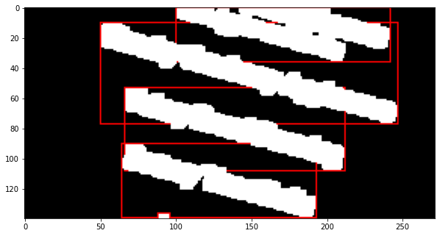
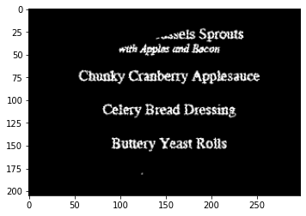
Rotation Angle
15
Bounding Boxes
Featureless Rotation
Rotating Original Image with angle that resulted from Featureless Rotation Technique

Slide 11
Dish Name Segmentation
OTSU Thresholding on Rotated Image
Line Dilation
Merging the Bounding Boxes
Cropping out each bounding boxes from the rotated image

Slide 12
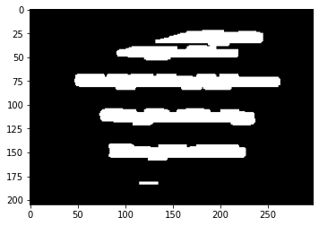
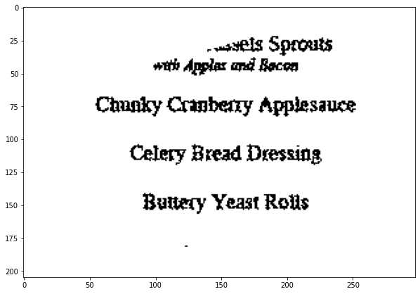
OTSU Thresholding & Line Dilation
OTSU Thresholding
Line Dilation
Structural element : (10,2) rectangle

Slide 13
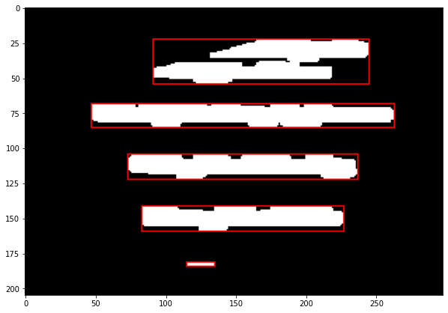
Merging Bounding Boxes
There Maybe bounding boxes which only consist on one word of dish ,while other word is bounded by other bounding boxes
So to create single bounding box consisting whole dish name , these bounding boxes which are almost in same line in horizontal orientation are merged

Slide 14
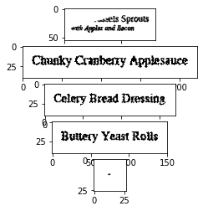
Segmenting Dish Names from bounding boxes
Crop Out each Bounding Box , and then give it to the OCR engine

Slide 15
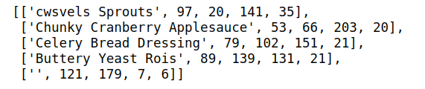
OCR (Optical Character Recognition )
MATLAB implementation of Tesseract algorithm, an open source OCR engine initially developed at HP Labs and currently managed by Google.
Libraries Available for python “Pytesseract”
https://pypi.org/project/pytesseract/

Slide 16
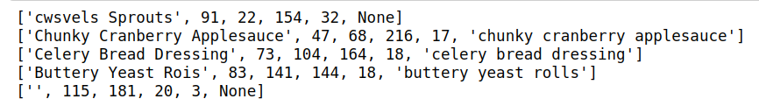
OCR Correction Algorithm
OCR May generate Spelling Errors
Algorithm of finding minimum edit distance given acceptable number of character mismatch, our system is able to correct the results from the OCR engine, which increases the overall success rate of image lookup.
Such as shortest Levenshtein distance, to resolve mismatched characters within a word

Slide 17
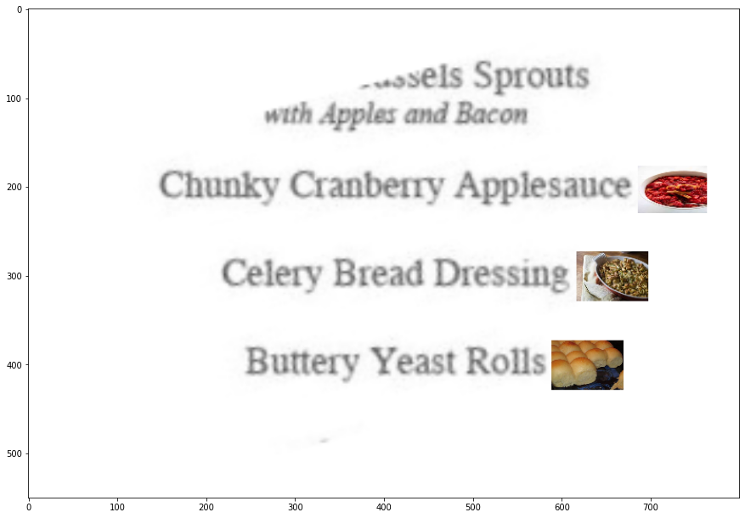
Final Output Generation
Original Image is Rotated with angle resulted from the Featureless rotation
Menu Image is scaled out ,to properly fit the dish images
Dish Images are then resized according to their bounding boxes and pasted beside the
Bounding box of the dish name

Slide 18
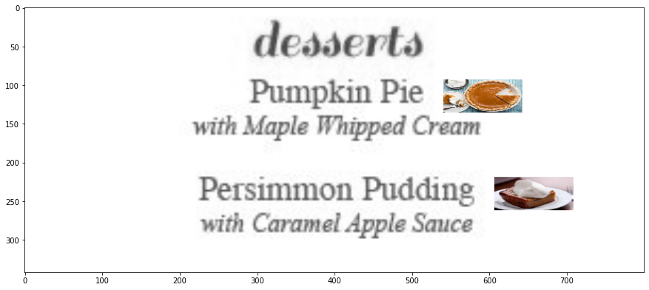
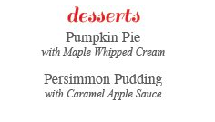
Examples

Slide 19

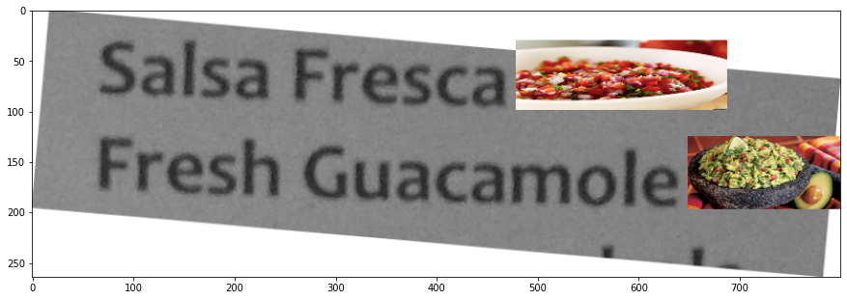

Slide 20

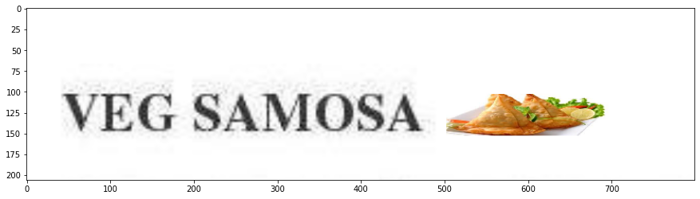

Slide 21

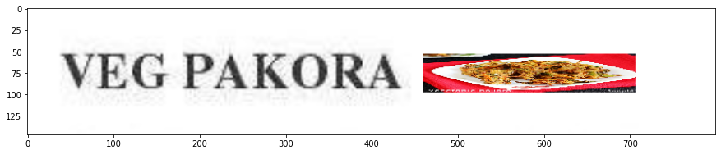

Slide 22
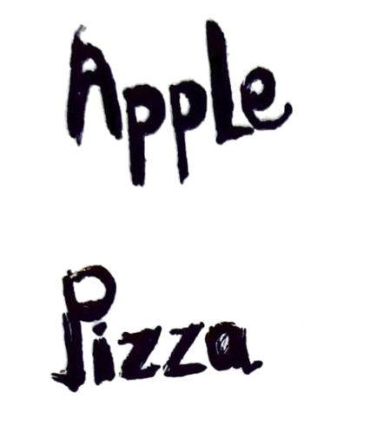
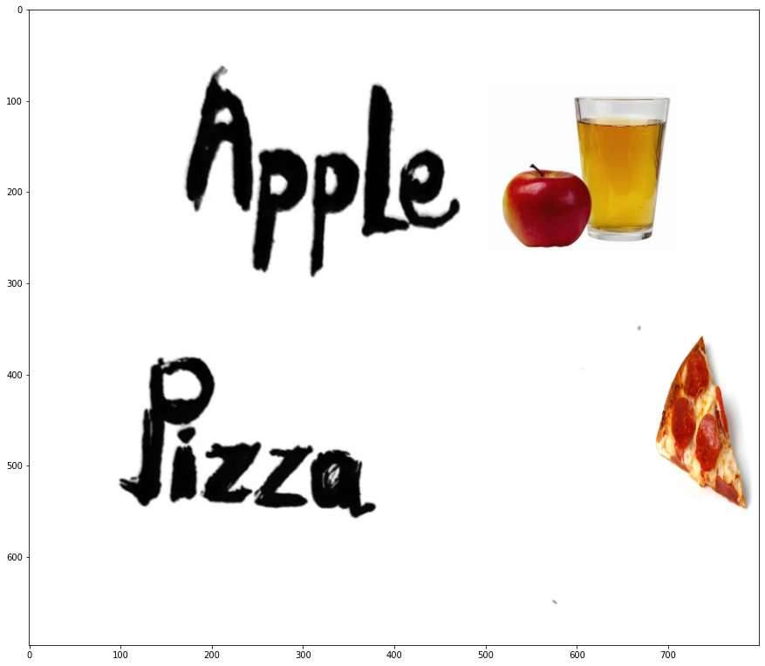

Slide 23
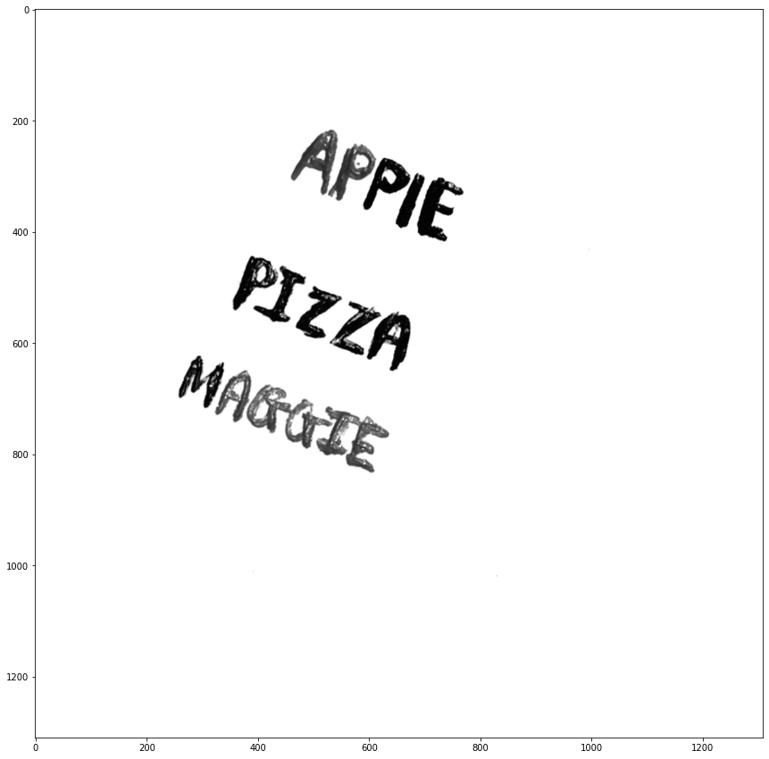
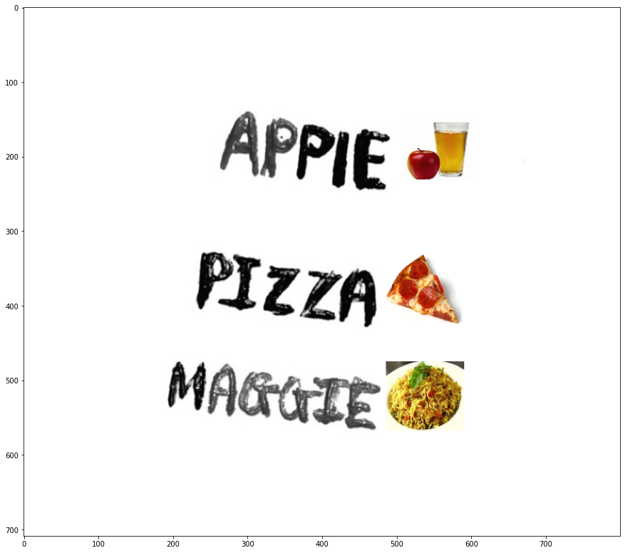

Slide 24
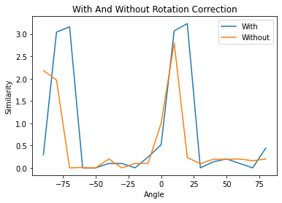
Experimental Results
OCR Correctness with and without Rotation Correction
OCR with rotation Correction Technique gives good result compare to the without rotation correction.
Low Performance of OCR with featureless rotation is due to the resolution drop due to rotation

Slide 25
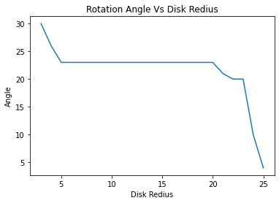
2. Featureless Rotation Angle generated from Different Disk Radius
Without any dilation at all, the identified angle of rotation is bit different from other angles
This is because characters are now considered as one connected component
hence the assumption that aspect ratio is the largest when rotated the image back to the actual angle is no longer valid.
When the structural element diameter is too big the identified angle of rotation is incorrect as well.
This is because all the words in the menu and the border of the menu is grouped into one single connected component and hence the aspect ratio does not represent the bounding box around a single English word
Original Rotation Angle : 23

Slide 26
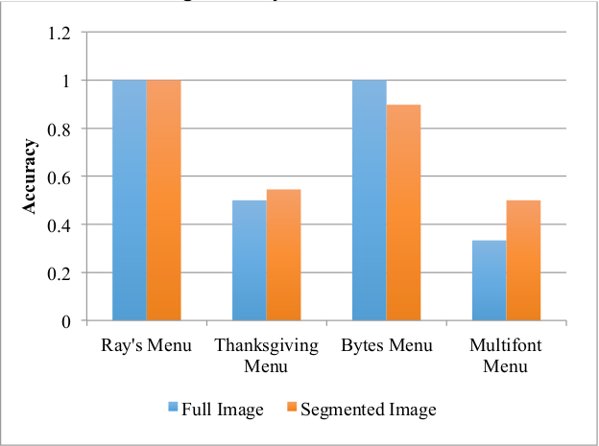
3. Passing Full image and Segmented Image into OCR
Source : https://web.stanford.edu/class/ee368/Project_Autumn_1516/Reports/Wang_Chen_Lang.pdf

Slide 27
Issues with the pipeline
OCR Accuracy Depends on the Font Styles and Fonts Sizes
Some Fancy font styles create inaccuracies in finding correct rotation angle which leads to the incorrect OCR Output
Very less line space may create large connected components and that may cause error in rotation angle detection
Noise , Intensity Gradient in the image heavily affects the Accuracy
Choosing the Thresholding Method
High allowed maximum edit distance in the OCR correction method may lead to wrong dish name selection.

Slide 28
Division Of Work
Tirth Pandit : Featureless Rotation , Experimental Analysis
Jay Krishna : Dish Name Segmentation , Experimental Analysis
Smit Khanpara : Final Output Generation , Examples
Pratik Tiwari : OCR Correction Algorithm , Examples
Dharmesh Gusai : Merging Bounding Boxes , Database Generation ,

